Slide 1

DMR
-Digital Mobile Radio
Patrick Hall
Ko4HEX
3/25/2021

Slide 2
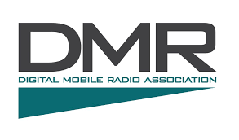



DMR Presentation
Part 1
Introduction to DMR
Part 2
How to use DMR
Part 3
Pros and Cons

Slide 3
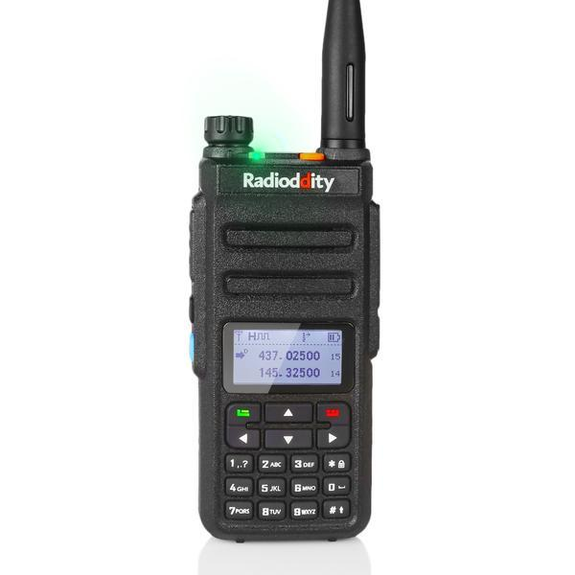
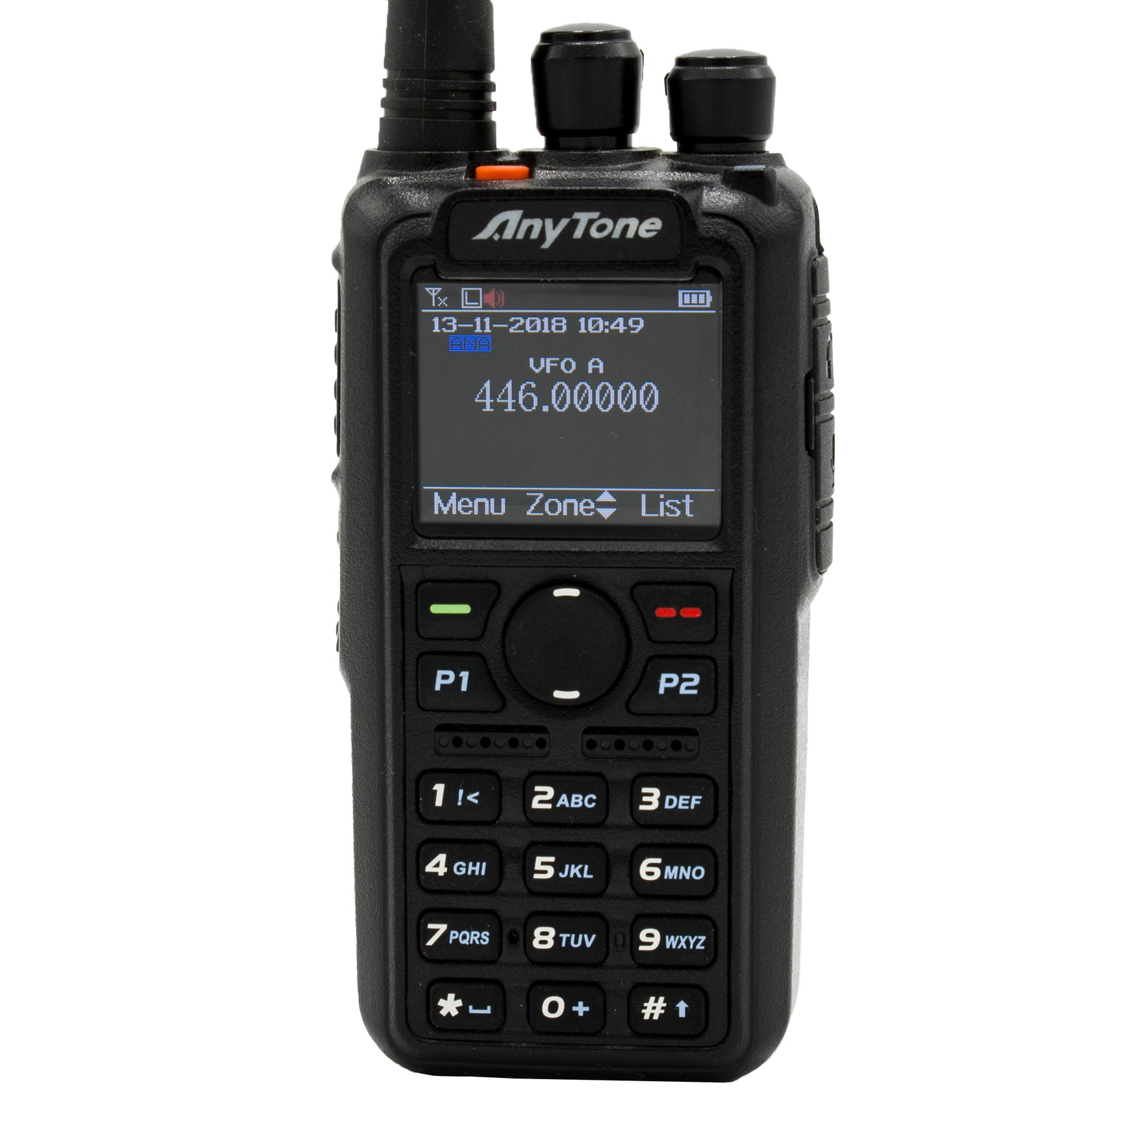
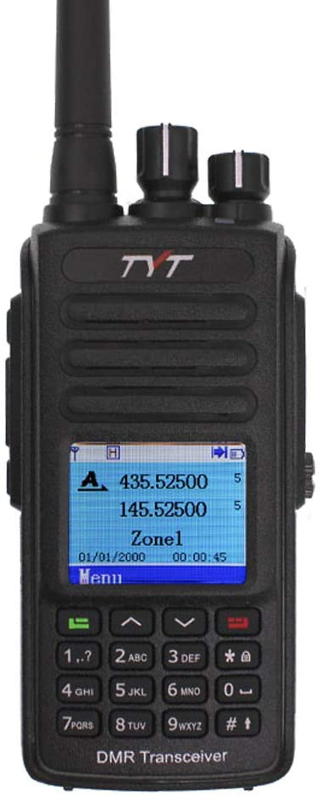
DMR Presentation
Part 1
Introduction to DMR
Part 2
How to use DMR
Part 3
Pros and Cons

Slide 4
Part 1
INTRODUCTION TO DMR
What is DMR
  DMR stand for Digital Mobile Radio
  Created by the European Telecommunications Standards Institute (ETSI) 2005
  Uses a network of DMR repeaters (Brandmeister) or Hotspots to transmit your signal through the internet worldwide

Slide 5
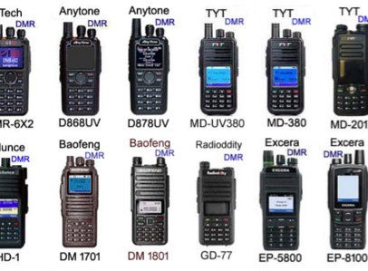
Part 1
Introduction to DMR
  TDMA ( Time Division Multiple Access)
    2 Time Slots
  Color Codes
    Tone
  Talk Groups

Slide 6
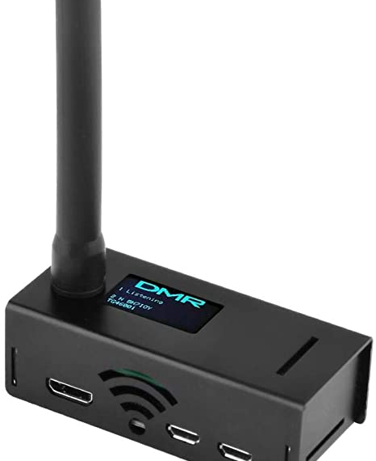
Part 2
How to use dmr
Technician
Radio ID (DMR ID)
  Radioid.net
Code Plug
  Digital Contacts
Hotspot- Register with Brandmeister

Slide 7
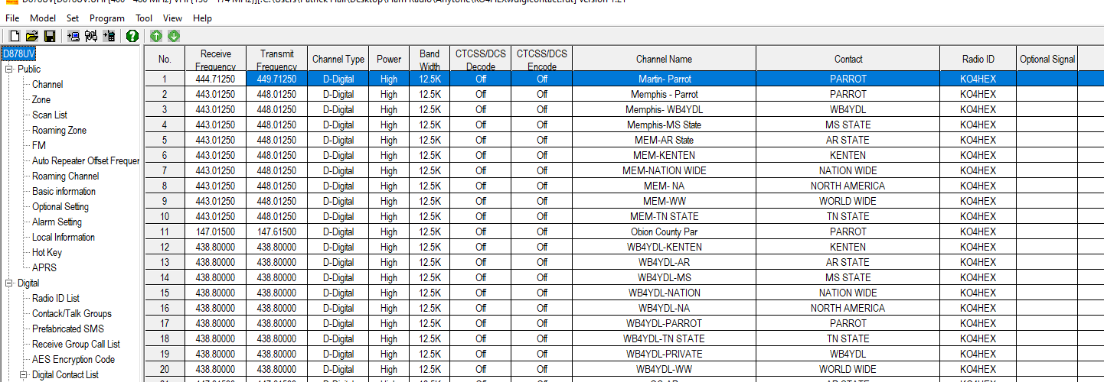
Code Plug

Slide 8
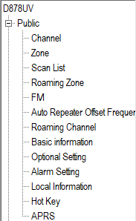
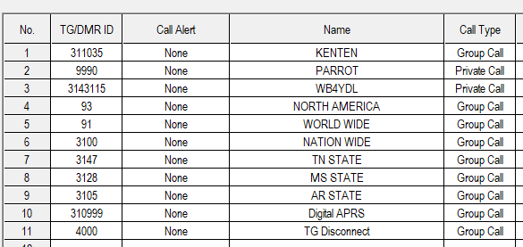
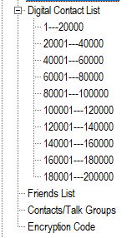
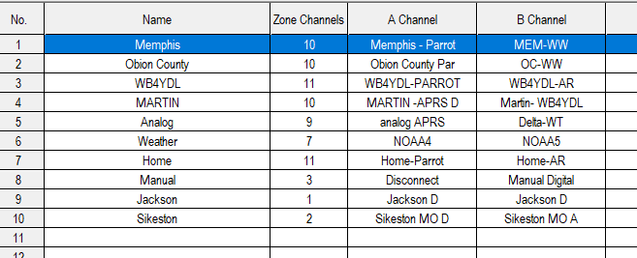
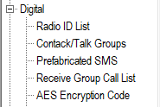
Code Plug

Slide 9
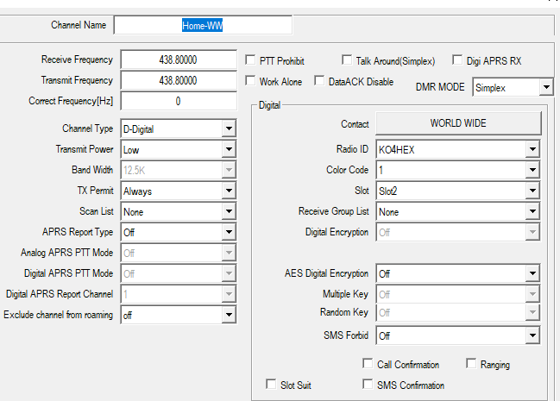
Code Plug
Zone
Talk Group
Contact
HS/R
CC
TS

Slide 10


Part 3
Pros and Cons
Pros
Cons
  Access to the world
  2 Time slots
  Sound Quality
  Technician
  Limited to repeater and hotspot range
  Code Plug programing learning curve

Slide 11
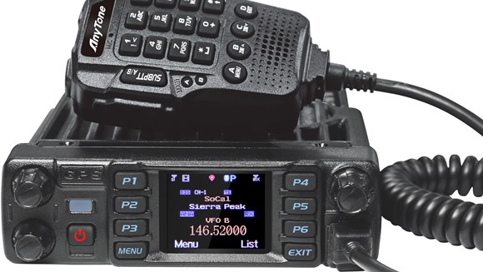
Bonus: Features
Thank you
Digital APRS
Scan Lists
Roaming
Digital Monitor/ Promiscuous mode
Private Calls
SMS
73!

